Slide 1
HCL Hi Tech Competitor Intelligence Report
Corporate Marketing & High Tech Marketing
TCS Internal
October 18, 2013
TCS Confidential

Slide 2
Table of Contents
Executive Summary
HCL High Tech Evolution
Financials Revenue Distribution Segment wise
High Tech clients as per segment
High Tech focus segments
Global Delivery Centers
Key Offerings in High Tech
High Tech Differentiators – Focus on R&D
Alliance and Partnership
Analyst Benchmarking
Key Investments and Focus of Future Investment
SWOT Analysis
Key Executives and profiles
Notes:
2
http://www.maxsave.bc.ca/
2

Slide 3
HCL Hi-Tech Overview

Slide 4
Executive Summary - High Tech
High Tech Segments and Focus Areas –
High Technology is a segment of Manufacturing vertical is approximately 40 to 50% of the Manufacturing vertical which comes to $ 600 – 650 Million. This is the highest revenue generating vertical of HCL which shows almost 9% of Y-o-Y growth.
Key subsegments of HCL Hi-Tech(according to TCS definition) are: Professional services, Server & storage, Semiconductor, Consumer electronics and Independent software vendors.
Key solutions that are provided by HCL in this Hi-Tech segment are: Agora, First 2.0, Dristhi, Wireless Gateway framework, HCL Aegis.
The strength of HCL is its technological competency in implementation of SAP-CRM, PLM according to customer requirement.
HCL Enterprise Application Services (EAS) provides robust Supply Chain Management solutions with advanced features and benefits helping organizations to generate value and enable their business through a more adaptive supply chain network.
Key focus of investment are disruptive new propositions like EFaaSTM, ALT ASM, Enterprise of Future and Innovation Monetization to continue to drive its differentiation in the transformational renewal market.
HCL provide Tier 1 and Tier 2 semiconductor Original Equipment Manufacturers (OEMs), fab and fabless design houses, and integrated device manufacturers with a comprehensive portfolio of engineering, manufacturing IT and automation, and enterprise IT solutions to enable strategic partnerships.
7 of the top 10 ISV companies work with HCL across different geographies including North America, Europe and Japan. HCL has engineered software for leading consumer software, enterprise software and Internet companies.
HCL’s acquisition of AXON combined the best of AXON’s strong business consulting and implementation capabilities and HCL’s robust global delivery-based application and infrastructure management capabilities.
HCL is a formidable cloud service partner for global organizations with coherent thinking and strategy in place & it works with 8 out of Top 10 ISV for cloud service.
HCL is in leader zone for R&D area for Computer peripheral & storage devices, Consumer Electronics, Semiconductors, Enterprise and Consumer Software as per Zinnov’s 2013 Global R&D Service Provider Rating . It shows HCL’s expertise in Hi-Tech.
Key Customer and Relationships in High Tech -
HCL key clients in High Tech segments are:
Computer Platform and Storage - 1) Xerox 2) EMC 3) NetApp 4)HP
Software segment - 1) Microsoft 2) Hybris 3) Guidewire 4) Salesforce 5) Teradata 6) JDA Software group
Electronics - 1)Philips India Electronic 2)Agilent Electronics
Professional Services - 1) Pricewatehousecoopers
Semiconductor - 1) Intel 2)Freescale Semiconductor 3)Texas Instruments
HCL is partnering with the world’s top software vendors like 1) Microsoft 2) SAP AG 3) HP 4)IBM 5)Cisco and others

Slide 5
HCL High Tech Evolution
2007-08
2009-2011
2012-13
HCL And nCore team up to develop Joint Technology for the Embedded Market Space.
HCL Opens European near-shore Delivery Centre in Poland.
HCL announces Three Year deal with Celestica Inc, other clients added in this period are SIDBI, Serena Software, Merck & Co., Inc.
HCL announces partnership with Mark Logic Corporation, Advanced Electronics Company In Saudi Arabia and makes Global Services Partnership with SAP to deliver joint business value through Customer centric ecosystem. Other important partner name is Adaptec, Inc,
Xerox Corporation announced a strategic global alliance with HCL Technologies. HCL will serve as a systems integrator for Xerox's managed print services offering - which helps companies control their office print environment to achieve continual cost savings and productivity gains.
HCL acquire Control Point Solutions, Inc.
HCL purchases 6.71 Million Axon Group PLC shares.
HCL AXON completes carve-out of Enterprise Solutions SAP practice of UCS Group.
HCL announces partnership with Optimation, Savvion, nMetric, Stellar Asia Pacific, Callatay & W outers (C&W), Odessa, Ketera Technologies, Ebaotech corporation, Finzsoft .
HCL AXON And NextLabs forge strategic Go-to-market partnership agreement to enhance Customer Data Security.
HCL enters into Global SAP ERP Services and Project Engagement with the Linde Group.
HCL Technologies Limited signs Five-Year, strategic engagement agreement with MSD
Key client added in this time frame are: Nokia, Microsoft (8.48b$ ), Electrolux, Sgx Signs, AI Majdouie Group, Array networks, Bluewater power, Hawlian electric.
HCL announces partnership with Texas Instruments
HCL Signs Deal with Novotech to implement Oracle's Siebel Clinical Trial Management System
HCL enters into strategic relationship with State Street to provide BPO services, Linedata, Hybris, Siemens PLM, PLM Software.
Key clients added in this time period are:
UPM Kymmene
Grindpoint,
Manitowoc,
Cobham,
Vestas,
Freescale semiconductors,
Philips India
The Enterprise Application Services (EAS) division of HCL Technologies Ltd announced that it has signed a transformational engagement with D+M Group (D&M Holdings, Inc.) to provide services in support of the deployment of SAP solutions.
HCL AXON announced that it has successfully developed a joint enterprise mobility solution on its HCL Citizen Connect platform as part of their global strategic alliance with Radio IP Software, the developer of advanced mobile virtual private network (MVPN) solutions.

Slide 6
HCL Financial Distribution
Segment wise Revenue FY13 Vs FY12
Verticals | FY2013 (in USD m) | FY2012 (in USD m) | Y-o-Y Growth rate
Financial Services | 1176.31 | 1018.65 | 15.47%
Manufacturing | 1312.22 | 1203.10 | 9.06%
Telecom | 342.11 | 342.91 | 0%
Retail & CPG | 417.09 | 357.85 | 16.55%
Media Publishing & Entertainment | 323.6 | 274.82 | 17.75%
Healthcare | 543.63 | 376.12 | 44.53%
Energy Utilities Public sector | 346.80 | 293.92 | 18%
Others | 224.92 | 281.05 | 19.97%
Total | 4686.5 | 4151.5 | 12.88%
High Technology is a segment of a Manufacturing vertical which is an annual revenue reporting segment for company.
HCL’s High Tech and Manufacturing verticals has grown significantly in last couple of Financial years. Latest YoY growth attributes to 9% and this is the highest revenue generating vertical(28% of total revenue) for HCL.

Slide 7
HCL Hi-Tech Client List

Slide 8
HCL High Tech Segment Wise Clients
Sr. No. | Client Name | Hi-Tech Segment | Deal Description | Link
1 | XEROX | Computer Platform | Xerox has awarded HCL a deal to provide end-to-end product engineering services. IDC estimates the deal to be US$125 million over 5 years. HCL will now handle certain aspects of Xerox's mechanical, electrical and software engineering activities for printing and imaging product lines, specifically platform development, infrastructure and quality assurance, according to Xerox. We can estimate more than 750 full time employees. | IDC
2 | EMC | Computer Platform | HCL is a Gold Tier Partner and a part of the Velocity Global Alliances Program - a ‘best in class’ Alliance Partner program. HCL delivers full lifecycle EMC based Documentum Content Management Solutions including Package Implementation, Customization, Support Upgrade/Migration, Reengineering . We can estimate more than 300 full time employees. | Link
 | Dell | Computer Platform | The Dell portfolio significantly adds value to the portfolio of HCL . Dell rationalizes the unique strength that HCL have very deep service capabilities specifically in the mid-market segment and also our unique value proposition of being able to provide services to tier 3 and tier 4 markets. | Link
3 | NetApp | Computer Platform | HCL will provide flexible, scalable and easy-to-manage secure multi-tenant storage environment for HCL Infosystems' O'zone Cloud Services. The partnership will help deliver IT-as-a-Service (ITaaS) and provide OPEX-based options for IT infrastructure to end-customers.HCL Infosystems will utilize industry-leading storage virtualization solutions from NetApp and work with NetApp to leverage its global experience in producticising features like Snapshot, FlexClone, Deduplication. We can estimate more than 100 full time employees. | Link
4 | HP | Computer Platform | HCL, as a Global Systems Integrator for HP, is able to offer a comprehensive suite of solutions to Customer by utilizing HP hardware and software platforms. Spread across 8 geographically dispersed centers and with a workforce of more than 11,000 employees, HCL BPO will now leverage Ensure IT as the single point of contact for end-user management. The newly deployed infrastructure management services will harness 400 plus server & network infrastructure at HCL BPO. | Link
5 | Philips | Electronics | HCL Care, HCL Infosystem's support and service division has been appointed to provide the contact center support services. The Contact Center is established at Noida for providing pan India service support. It is worth 15m$ deal & will continue for 5 years. The partnership also marks HCL's foray into after sales services in consumer lifestyle product space. | Link
6 | Agilent Technologies | Electronics | Agilent Technologies, HCL delivered Oracle Commerce Applications, a leading commerce solution. This innovative solution from HCL leverages best-of-breed Oracle technologies to help deliver faster performance. HCL‟s Oracle Commerce and Oracle Sales Cloud will be demonstrated by leading experts at OOW. | Link
7 | Toshiba | Electronics | HCL Infosystems’ channel strengths will play a formidable role for Toshiba in penetrating newer markets and segments within the country and reach a large customer base. The latest e-STUDIO models have been designed specially to serve the Office MFD segment and they are best suited for small to medium size work groups. | Link
8 | Teradyne | Electronics | HCL Technologies today said it has won a $70 million five year contract with Teradyne, a leading supplier of automatic test equipment, which could go upto $125 million. | Link

Slide 9
HCL High Tech Segment Wise Clients
Sr. No | Client Name | Hi-Tech Segment | Deal Description | Link
9 | Casio India | Electronics | HCL Infosystems Ltd has tied up Casio India Co Pvt Ltd to market digital cameras. It had entered into an arrangement with Casio India for marketing, selling, leasing and servicing of digital cameras in the country | Link
10 | SAP | Software | HCL develops and markets SAP based solutions. Its iMRO is an SAP-endorsed Business Solution. iMRO, is an industry solution add-on for the SAP ERP application. HCL is a product development partner at SAP Labs Shanghai, Bangalore and Palo Alto. | Link
11 | Microsoft | Software | Reportedly, HCL has been awarded 5-year IT services contract by Microsoft. HCL will act as a strategic vendor for offering IT services for Microsoft's online services business.IDC estimates the contract is potentially worth US$130 million.IDC believes that the deal was signed in early 2009 and include both datacenter and applications. We can estimate more than 1500 full time employees. | IDC
12 | Salesforce.com | Software | HCL offers services assisting customers in aligning their Salesforce.com CRM strategy and processes with their business strategy thereby enabling them to derive maximum value from Salesforce.com investments. HCL’s end to end service offerings, built on the strength of deep domain expertise and rich repository of accelerators, drive organizational change and improve adoption levels substantially. | Link
13 | JDASoftware | Software | Beginning with its experience implementing JDA solutions in India and APAC, HCL has expanded its focus to include key markets in EMEA and Americas as a global JDA partner. As a result of its work over the past five years, HCL has strengthened its JDA practice and now provides end-to end services across JDA’s complete portfolio of retail and supply chain solutions, offering deep experience and a proven methodology across demand forecasting, replenishment, inventory management and supply chain optimization. | Link
14 | Hybris | Software | This partnership will strengthen HCL’s portfolio to provide end-to-end omni-channel commerce solutions and integration services to its customers worldwide. This combination of HCL’s domain and technology expertise, along with hybris’ market leading commerce platform, will help business decision makers change the game by improving the quality of the customer buying experience, thereby extending brand loyalty and spend. | Link
15 | Guidewire | Software | HCL has a partnership with Guidewire and offers business benefit oriented solutions on Guidewire products through robust frameworks, methodologies and solution accelerators globally since 2004. HCL is a Guidewire partner with implementation experience spanning each of the products in the Guidewire Insurance Suite: ClaimCenter, Policy Center and Billing Center. Our Guidewire customers have won awards from Guidewire, IASA, and Celent for their Guidewire implementations. | Link
16 | PwC | Professional services | An estimate of more than 100 dedicated employees are working on it. | NA
IDC Contract List(existing)

Slide 10
HCL High Tech Segment Wise Clients
Sr. No. | Client Name | Hi-Tech Segment | Deal Description | Link
17 | Intel | Semiconductor | An estimate of more than 100 dedicated employees are working on it. | NA
18 | Micron | Semiconductor | An estimate of more than 100 dedicated employees are working on it. | NA
19 | KLA Tencor | Semiconductor | HCLT has been engaged in software development with KLA-Tencor for over a year now. The current projects encompass the complete Software Development Life Cycle (SLC) for KLA-Tencor and includes the development of new software components for the next generation wafer inspection systems. | Link
20 | Avago Technologies Limited | Semiconductor | HCL in a strategic co-sourcing engagement centered on managed services to reduce operational costs and increase IT operational transparency – all without disrupting the business operations of more than 40,000 customers worldwide. By leveraging HCL’s strong SLA-driven framework, Avago has achieved greater control over its IT infrastructure and the ability to refocus on key business objectives. | Link
21 | Freescale Semiconductor | Semiconductor | The agreement(5 Years, 70 million$) will help Freescale to develop more resilient systems optimize its operational costs, increase visibility into IT operations, experience reduced technology complexity and improved quality. | Link
22 | AMD | Semiconductor | HCL Technologies (HCLT) announced that it has signed a multi-year, 105 million dollar collaborative IT cosourcing contract with AMD. The strategic co-sourcing deal involves IT infrastructure management, maintenance and support of global IT applications. The services will be delivered out of HCL's facilities in India, part of which will be dedicated for AMD. | IDC
23 | Texas Instruments | Semiconductor | HCL leverage this partnership in building product components and solution accelerators for three major segments - Aerospace, Medical Electronics and Consumer Electronics with a specific focus on medical imaging, wireless communication and analog system applications. | Linkt

Slide 11
HCL Hi-Tech Segmental Focus, Strategy & Solutions

Slide 12
HCL High Tech Segment Focus Strategy: ISV
HCL Expertise
Market leadership: Leading industry analysts have rated HCL’s software engineering capabilities in enterprise and consumer software engineering in their leadership quadrant. The rating comes from over three decades of experience and working with over 150 software and internet properties.
Productized solutions and services. HCL’s maturity by working with over 70 enterprise and consumer ISVs in software engineering has led to us developing accelerators to aid faster product development and ensuring better quality compliance thus delivering great value to our customers and ultimately the end consumer. A dedicated team of over 500 experts across technologies continuously develops and improves 20+ solutions to aid your software development process.
Rich and diverse experience. 7 of the top 10 ISV companies today work with HCL across different geographies including North America, Europe and Japan. HCL has engineered software for leading consumer software, enterprise software and Internet companies. HCL experience not only spans various stages of the PDLC but also caters to different business requirements through flexible engagement models.
Richer mobility experience. HCL’s mobility solutions enable organizations to become highly productive and customer centric, by making information available at the right time to the right person – all through a simple click! HCL’s Mobility CoE offerings include mobile application development, enterprise mobile offerings, system integration services, and managed services. Key current partnerships include Sybase and RIM. HCL is investing in this space with initiatives like the Network Solution Lab, a Dedicated Mobility Centre in Singapore, and through University Programs.
HCL Offerings
Software product engineering – End to end product engineering for enterprise software, consumer software and Internet properties across all stages of the SDLC from conceptualization to go-to-market
Platform engineering – Internet and digital properties development; Ecommerce capabilities across multiple platforms
Emerging technologies like mobility and cloud – HCL frameworks on rapid application development and testing, device compatibility, interoperability and SaaS enablement deliver value across ISV segments
Software quality and compliance – 1000+ testing frameworks and three decades of experience power the testing capabilities at HCL
Software re-engineering – End of life support, enhancements and feature addition, product sustenance and support, and technical support services

Slide 13
HCL High Tech Segment Focus& Strategy: ISV
Powering Revenue Growth
New Delivery Channels in existing market
SaaS has revolutionized the way ISVs deliver, manage and support software. Most of the ISVs are moving towards the more viable licensing models that SaaS offers. HCL is the only offshore services vendor to provide “SaaSification” solutions for Deployment, Hosting, Billing and Managing. To enable ISVs Saasify their products, HCL has created a Multi-tenant, SOA enabled SaaS enablement platform AGORA.
Accessing Untapped Market Segments through Web2.0 Enablement
Since the beginning of search and social networking, HCL has engineered web products and services across domains which fully harness the power of Web2.0 Some examples from our diverse engagement include a Real estate search website, Travel portal, Leading content portal, Geo-spatial search and mash-ups among others.
To enable ISVs launch Web2.0 based services, HCL has created FIRST2.0, a seamless integrated offering for Product Engineering and Infrastructure Services.
Reaching Every Customer through Mobile Enablement
Application porting and optimization for new mobile platforms
Application enhancements and Maintenance
Product development /Localization
Mobile 2.0 applications
Product testing for different networks for performance and functional issues
Product Globalization to enable Accelerated Geo Penetration
Capabilities for accelerated product globalization:
18N and L10N – Proven processes and methodologies for product internationalization and localization
Language Experts – Large team of language experts with expertise in languages and cultural sensitivities
Experience – 200+ person years of experience in Globalization Services
Benefits:
Faster Rollout for target locations – Enhanced business spread
Reduced costs due HCL’s frameworks and experience
One stop shop – Technology, Translation and Transition
Notes:
http://www.hcltech.com/independent-software-vendors/powering-revenue-growth

Slide 14
HCL High Tech Segment Focus& Strategy: ISV
Powering Revenue Growth
Optimizing Business Critical Applications to Increase Customer Centricity
Key Frameworks:
EiAM (Engineering in Application Management) – HCL’ s framework for identifying BCAs and introducing engineering services processes and methodologies for supporting BCAs
BAIT (Business Aligned IT) – HCL’s renowned framework for aligning IT strategy and implementation with business strategy and processes
Key Benefits:
CA architecture, scalability, design, retooling, testing, release, build and sustenance managed in the same way as the product that’s built for external end customers
Key BCAs aligned to sales/marketing objectives and priorities – not just CIO’s ownership and his priorities
Deliver Business Differentiating solutions through convergence of Business and IT teams
Business Analytics to Discover New Revenue Streams
HCL covers a triad of services in the Business Intelligence arena
Base BI services – Running and maintenance of Analytical Models and Report Generation
Advanced BI services – Predictive and Inductive Analytics, Analytics Modeling
Consulting – SCM and CRM Analytics
Key Benefits:
Risk free data driven business modeling
Zero dollars spent on data quality
Global Reporting and Analytics Factory (GRAF) to create the perfect assembly-line reporting factory for business
Notes:
http://www.hcltech.com/independent-software-vendors/powering-revenue-growth

Slide 15
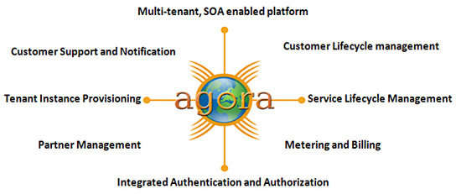
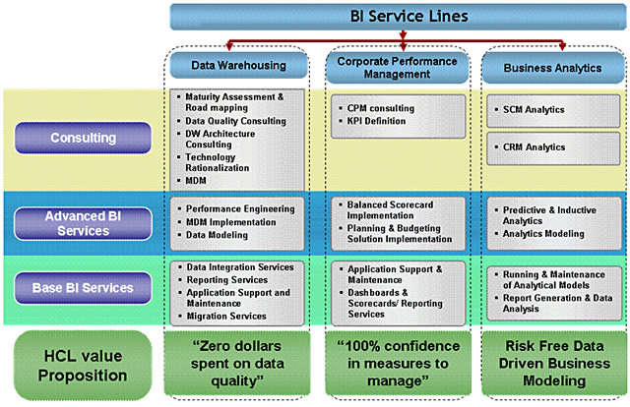
HCL High Tech Segment Focus& Strategy: ISV
Powering Revenue Growth
AGORA
Business Intelligence
Notes:
http://www.hcltech.com/independent-software-vendors/powering-revenue-growth

Slide 16
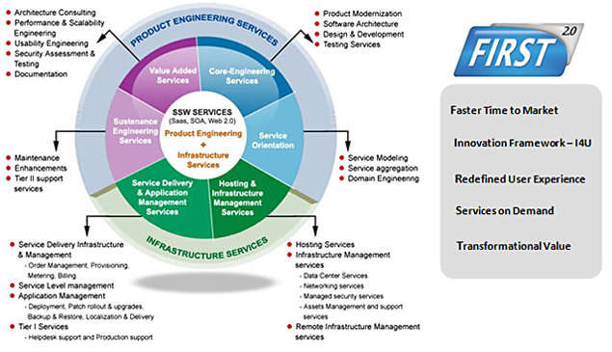
HCL High Tech Segment Focus& Strategy: ISV
Powering Revenue Growth
FIRST 2.0

Slide 17
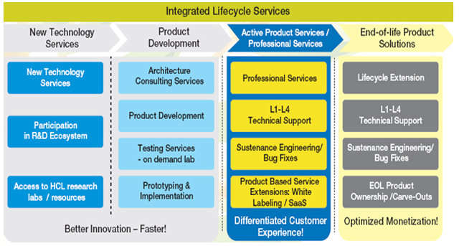
HCL High Tech Segment Focus & Strategy: ISV
Transforming and R & D
Integrated Product Lifecycle Services

Slide 18
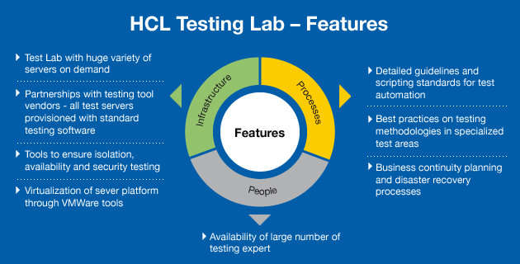
HCL High Tech Segment Focus & Strategy: ISV
Transforming and R & D
On Demand Software Test Lab
Key Benefits
One of the largest offshore-based software testing infrastructure – with more than 140 high-end servers with single/multiple CPUs across all platforms (Dell, HP, IBM, Sun etc.)
Niche testing services – High availability/Scalability testing with clustering and load balancing, Firewall testing etc.
Access to vast pool of specialized testing resources
Test product remotely with in-house testing team using lab-on-rent model
Affordable pay-as-you-go models

Slide 19
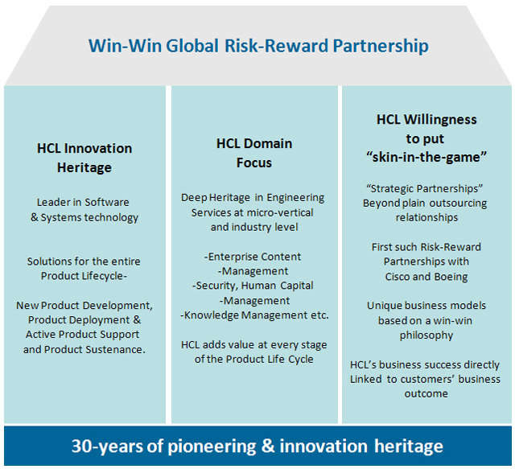
HCL High Tech Segment Focus & Strategy: ISV
Transforming and R & D
Global Risk Reward Partnership (GRRP)

Slide 20
HCL High Tech Segment Focus & Strategy: ISV
Transforming Business Operations
Monitoring Spend Management
Offerings:
ETL tool enabling extraction of all spend data from internal and external business cube
Automated item level cleansing, classification and de-duplication through web enabled spend analysis tool
Querying and Report generation at the End User level
Reports on spend by Vendor, Commodity, Geography, Preferred supplier, and Spend range
Business Benefits:
View accurate spend information at the aggregate and line item level
Rapidly identify time-sensitive savings opportunities
Enhanced financial and business reporting & analysis
Eliminate duplicate suppliers
Cut excess stocks, lower inventory costs and reduce expediting cost
Business Benefits Realization Approach for SAP-enabled Enterprise Applications
Business Benefits:
Have a clear indication of where and how to release cash in the business
Have the financial rationale to support any investment required to release this cash
Ensuring planned improvements in business performance are reflected in management reports and benefits attainment are tracked
Deploying Managed Application Services
Features:
Fixed Price for Application Support with capacity-based model for maintenance
Comprehensive tooling framework for Managed Services lifecycle
Committed productivity improvements
KPIs for Value Adds and Transformational Ideas
Web-based portal for comprehensive engagement visibility
Resource and Demand Management tools
Global Delivery Model with offshore leverage
Notes:
http://www.hcltech.com/independent-software-vendors/transforming-business-operations

Slide 21
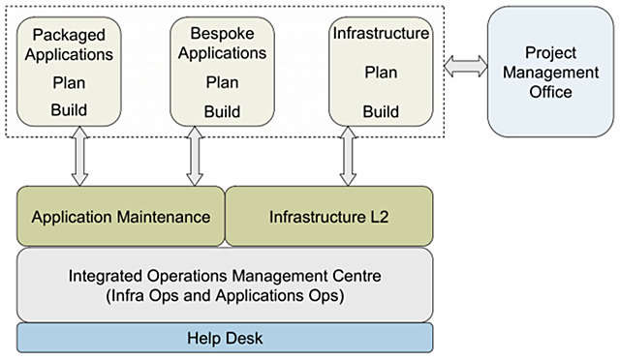
HCL High Tech Segment Focus & Strategy: ISV
Transforming Business Operations
Consolidating IT Operations
Offerings:
Setting up a common helpdesk for Applications and Infrastructure by cross-skilling people and using common processes and methodologies
Consolidating command centers and operating platforms/tools
Optimizing FTE coverage to achieve 24x7
Rationalizing third-party tools contracts for IT management
Business Benefits:
Savings of up to 40% in tools and process costs
Lessen operations downtime – increase speed of operations
Reduce risk – increase real time monitoring capability
Savings of up to 20-25% redundant staff costs
Notes:
http://www.hcltech.com/independent-software-vendors/transforming-business-operations

Slide 22
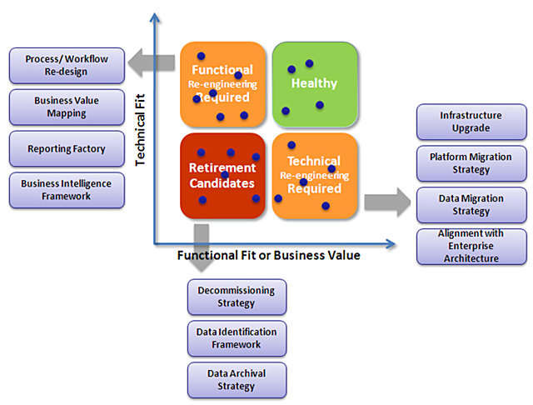
HCL High Tech Segment Focus & Strategy: ISV
Transforming Business Operations
Rationalizing the Application Portfolio
Key Benefits
Implementation of HCL patented Prizm™ Application for real-time IT health assessment
Reduction in number of applications by retiring redundant candidates
Optimization of the mix of organic and inorganic additions to the portfolio
Creation of a lean list of IT initiatives
Outsourcing, Consolidation, Migration and Modernization recommendations
Reduction in number of licenses and migration to lower cost platform
Increase in user satisfaction by improving business critical applications

Slide 23
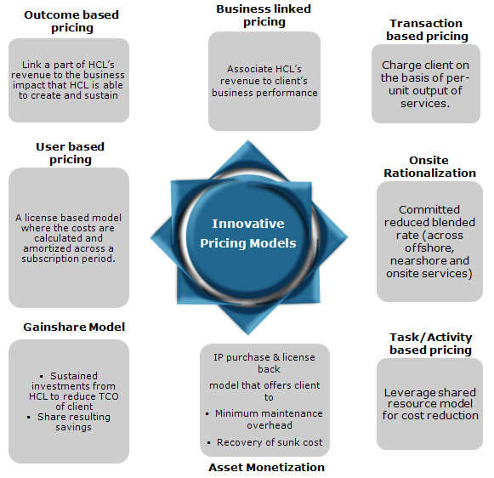
HCL High Tech Segment Focus & Strategy: ISV
Transforming Business Operations
Innovative Pricing Models

Slide 24
HCL High Tech Segment Focus:
Consumer Electronics
HCL Expertise
Deep market knowledge:. HCL partners with customers to develop easily integrated multifunctional solutions that enhance the digital experience. Their ability to leverage technology across verticals such as telecom, ISV, and storage — combined with deep domain expertise in areas like cloud and SaaS, mechanical and IDE, VLSI, and systems engineering.
Concept-to-manufacture expertise. HCL has traced the entire cycle from concept to manufacture, at an accelerated pace, for some of the world’s leading consumer electronics companies in product categories such as cameras, tablets, and VoIP headsets.
Accelerating product launch: Leveraging a decade of experience in this industry, HCL has developed plug-and-play solution accelerators that can reduce launch cycles substantially.
A finger on the pulse: With extensive experience in evolving segments such as digital home, white goods, and consumer imaging, HCL has been ranked a leader in consumer electronics by Zinnov for the maturity and relevance of its services in this industry.
Comprehensive IT solutions: For over thirty years, HCL has been providing IT solutions across application managed services, application testing, CRM, aftermarket services, infrastructure management, business process outsourcing, and product life cycle solutions.
Enterprise Application Services: HCL’s acquisition of AXON combined the best of AXON’s strong business consulting and implementation capabilities and HCL’s robust global delivery-based application and infrastructure management capabilities. HCL deliver unique value on an end-to-end basis for SAP, Oracle, and Microsoft customers, ensuring that they receive the optimal business transformation solution at the right price.
Richer mobility experience: HCL’s Mobility CoE offerings include mobile application development, enterprise mobile offerings, system integration services, and managed services. Key current partnerships include Sybase and RIM. HCL is investing in this space with initiatives such as the Network Solution Lab, a dedicated mobility center in Singapore, and through alliances with several universities.
HCL Offerings
Hardware: Board and system design, FPGA/ASIC design, verification and validation, and value-added services
Mechanical: Conceptualization, design and development, implementation manufacturing, active product support, and end-of-life products
Software Engineering: Product development, software framework and SDK development, middleware/open source components, sustenance engineering – end of life cycle, and active product support
Product Testing: Test automation framework development, conformance test suite development, automated test bench development, IOT testing, field testing, functional testing, regression testing, protocol conformance testing, and wi-fi.

Slide 25
HCL High Tech Segment Focus
Consumer Electronics: Services Portfolio
Home Entertainment
Services to Platform vendors
Services to OEM/ODMs
Services to ISV/Service Operators
Reference Application Development
OS Porting & Porting/Development of Device Drivers for different peripherals
BSP Development and porting
Device Driver Integration
Integrating communication protocols – IEEE 1394, UPnP, HDMI
Porting and optimization of codecs of various processors such as ARM, DSP, etc.
Testing and Test automation
Benchmarking of various processors (SoC) targeted for DTV, BlueRay player, STB
Develop diagnostics to assist in board bring up and verification
Complete Concept to Manufacturing Services
DTV component customization and modification to reference design (S/W & H/W)
Customization of reference software for end-customer requirements
System testing of customized solution
Development of multimedia solution for STB/HDTV devices
Proven expertise in bug tracking/fixing, release management and customization of code
Compliance and IOT Testing
Home Networking Solutions IP
Complete development of audio components of Digital Home devices
Application of high degree software optimization techniques to reduce the timing complexity of various multimedia components such as encoders and decoders.
Development and integration of DLNA components for multimedia player solution.
Design and development of reference application software for digital modules of DTVs
HCL’s proprietary HEAT (HCL Embedded Application Testing) COE with partnerships with leading tools vendors; specialized consulting and testing services
Complete development, integration, Testing, Complete Maintenance and release of Digital Home Applications
Development and integration of STB Middleware
Cross platform migration of multimedia solutions
Application testing on multiple platforms
Porting and customization of media DSP

Slide 26
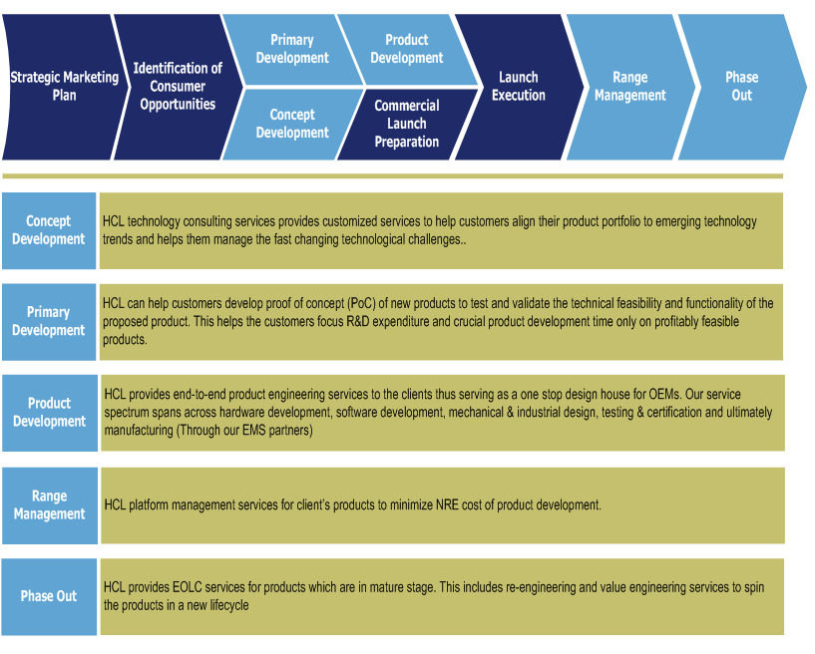
HCL High Tech Segment Focus
Consumer Electronics: Services Portfolio
White Goods

Slide 27
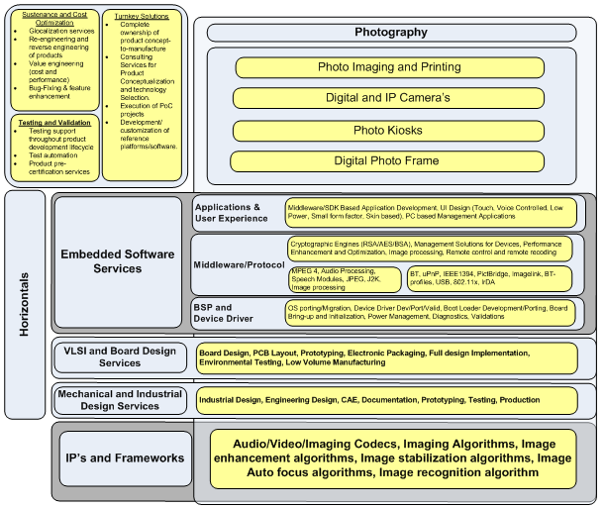
HCL High Tech Segment Focus
Consumer Electronics: Services Portfolio
Consumer Imaging

Slide 28
HCL High Tech Segment Focus
Consumer Electronics: Solution & Framework
Drishti
Key Features
Service Oriented Architecture facilitates seamless and quick integration with existing applications
Multi-floor / Multi-wing Visualization Support
High Accuracy Algorithms for Locating
Standard communication layer for active RFIDT ags:
Agnostics to RF Technology (Currently
supports 2.4 GHz (Wi-Fi / ZigBee))
Continuous Monitoring of Tracked tags
Low Battery warning support
Optimized 'Server - Tag' Network Protocol to efficiently utilize the tag battery power
Continuous Tracking Support
Alert & Notification module to integrate custom alerts
Prohibited Zone entry warning with adjustable accuracy
Access the application any time any where
Robust Security Architecture
Intuitive UI with Desktop and PDA support
Proprietary Router Auto Placement algorithms
Multi-color RF coverage Map for Routers on a floor
Supports End Device Configuration
Multifloor / Multiwing Planning Support
Multifloor / Multiwing Visualization Support
Indication on the cost of Infrastructure setup
Percentage Area RF coverage indicator
Target Applications
Patient Locating
Staff Locating
Patient record/file Locating
Asset Locating – including wheelchairs and intravenous pump
Crash cart and inventory Locating
Lab operations management

Slide 29
HCL High Tech Segment Focus
Consumer Electronics: Solution & Framework
Wireless Gateway Framework
Key Features
Fire and intrusion alarm detection from wireless smoke, CO, Motion and contact sensors
Event triggered video and image recording (pre- and post-trigger) in 3GP QCIF/QVEGA formats.
Pre and Post event video recording through network IP camera up to 5FPS
Event reporting with associated video attachment through Email and MMS
Event logging for up to latest 512 events for post event analysis and video play back
Secured web based (https) global system access and control via web-browser-based user interface running on Personal Computer, Mobile Phones
Technology/Domain
Wi-Fi
Wireless security sensors smoke, CO, Intrusion
MPEG4 (3GP) video recording from network IP camera which essentially involves
RTP/RTSP based live streaming to PC/mobile over internet
J2ME for mobile interface to the Security gateway
Embedded Web Server
Secured SMTP and POP3 client for Email notification
Benefits
End to end security enabling
Solution leveraged using HCL’s IP for MPEG4 codecs
Notes:
http://www.hcltech.com/consumer-electronics/wireless-gateway-framework

Slide 30
HCL High Tech Segment Focus
Consumer Electronics: Solution & Framework
Codecs & Transcoders
1. Codec’s Porting among different platforms
Porting of codecs on ARM and TI DSP processors
Porting of MPEG-4 and AVC decoder on various RISC and DSP processors including SH5, Xtensa, OMAP, DM270
2. Development of applications supporting codecs
Development of test harness for codec testing
GUI and application customization of 3GPP/MP4 player on multiple platforms
3. Memory and Speed Optimization
Optimization of Mpeg4 & AVC Decoder for memory, MIPS, and code size
Memory and Speed Optimization done at different Level ( C code and ASM Hand coding) minimal execution time
4. Compliance Testing
Compliance to the Baseline Profile of AVC and Simple Profile of MPEG-4
5. Adding support to existing applications
Added support for H.263, MP4, AMR, AAC codecs to multimedia player on BREW platform
Enhanced media player by adding support for MPEG, 3GPP, and other proprietary multimedia formats
6. Platforms Supported
Symbian
Pocket PC
Palm OS
mITRON
TI’s DSPBIOS
Nucleus-Plus
SH Mobile
Mclinux
Android
Notes:
http://www.hcltech.com/consumer-electronics/codecs-transcoders

Slide 31
HCL High Tech Segment Focus
Consumer Electronics: Solution & Framework
Agora
HCL's proprietary solution AGORA is the only one of its kind in the market that provides complete metering, billing and monitoring solutions for software provided as a service. The unique advantage of Agora is that customers can plug in their products and services and immediately start delivering products on subscription.
Benefits:
Automate Usage Data collection and Collation for pricing
Convert Usage into any required units
Minimize revenue leakage and Quickly monetize by choosing amongst several pre-set and customizable pricing models based on:
Usage
Transactions
One-time, Recurring/Rental # of devices managed or User using the Service
Configurable rate cards and Trials
Home Networking Stacks
HCLT provides a complete IEEE 1394-1995 software stack with support for protocols running over the 1394 transport
Bus Driver: Bus driver is the device driver for controllers (OHCI 1.0, PCILynx)
HCLT 1394 API : Rich set of APIs allow design flexibility to the application protocols
AV/C Controller Unit: This component provides support for controlling various AV/C command suite compatible target devices
DPP: This component implements the IEEE 1394 DPP protocol for interfacing with the printer devices supporting 1394 link

Slide 32
HCL High Tech Segment Focus
Semiconductors
HCL Expertise
Comprehensive experience. For more than a decade, six of the top ten semiconductor manufacturers and five of the top ten design houses have depended on HCL for scalable, flexible, and transformational solutions. HCL provide Tier 1 and Tier 2 semiconductor Original Equipment Manufacturers (OEMs), fab and fabless design houses, and integrated device manufacturers with a comprehensive portfolio of engineering, manufacturing IT and automation, and enterprise IT solutions to enable strategic partnerships.
Engineering know-how. HCL offers a one-stop shop for engineering design services in concept, architecture, design implementation, synthesis, physical design, obsolescence management, and post-silicon validation. They also address the 450mm R&D challenges that the industry is currently facing.
Expertise. Their extensive partnerships with customers have allowed us to build a deep base of knowledge and expertise in transforming their business processes while optimizing their operational costs.
A reputation for “firsts.” HCL were the first certified power PC design center outside an IBM business unit; the first Indian company to be awarded Frost & Sullivan’s 2005 Customer Value Enhancement award in the semiconductor domain; and the first Indian services company to set up complex infrastructure — such as a class 10,000 clean room for housing tools and an advanced ATE lab — for customers.
Comprehensive IT solutions. For over thirty years, HCL has been providing IT solutions across application managed services, application testing, CRM, aftermarket services, infrastructure management, business process outsourcing, and product life cycle solutions. Their “ALT ASM” solutions have helped clients reduce their IT costs by over 30% and have helped ensure a seamless and transparent model that links service level agreements to business-level KPIs.
Enterprise Application Services. HCL’s acquisition of AXON combined the best of AXON’s strong business consulting and implementation capabilities and HCL’s robust global delivery-based application and infrastructure management capabilities.
Richer mobility experience. HCL’s mobility solutions enable organizations to become highly productive and customer centric by making information available at the right time to the right person – all through a simple click. HCL’s Mobility CoE offerings include mobile application development, enterprise mobile offerings, system integration services, and managed services. Key current partnerships include Sybase and RIM. HCL is investing in this space with initiatives such as the Network Solution Lab, a dedicated mobility center in Singapore, and through alliances with several universities.
Notes:
http://www.hcltech.com/semiconductors

Slide 33
HCL High Tech Segment Focus
Semiconductors: Service Portfolio
Hardware Product Engineering
HCL offers domain-specific hardware engineering and design services in VLSI ASIC, FPGA, and SoC engineering, board design, embedded software, mechanical engineering, and design, prototyping, and value-added engineering services such as compliance engineering, independent verification and validation and low volume manufacturing. HCL offer these services for partial lifecycle product engineering and for full lifecycle solutions.
HCL’s hardware design capabilities have been built and refined over the decades and enriched with specialist partnerships to provide spec to silicon engineering services to OEMs and component manufacturers in verticals like aerospace, automotive, hi-tech, medical electronics, consumer electronics, computer architecture, networking, and storage.
Embedded Engineering Services
HCL is a leader in developing embedded software and systems for various industries and domains. They have expertise in safety-critical embedded systems with more than 2000 person years of cumulative experience in developing small footprint and safety-critical embedded systems for Medical Devices, Automotive Electronics and Aircraft Components.
HCL use DSP expertise and IPs to develop fast embedded middleware, rich applications and interactive GUI for consumer electronics, computer peripherals and telecom products. Their embedded systems group comprises of a large talent pool of engineers and equipped with competencies in a range of programming tools, microprocessors and real-time operating systems.
Electrical Engineering & Prototyping
Conversion of PTH components to SMT
Replacement of obsolete components
Compaction of Design
DFx audit and process improvement
Redesign of the system and boards
Reverse Engineering
Enterprise Application Services
Enterprise Application Services (EAS) practice at HCL offers package and platform-led services to transform customer’s business and IT operations. The group leverages its Blue Ocean global alliances with SAP, Oracle and Microsoft to deliver services spanning from blue printing, development, deployment, global rollouts to application maintenance and support in areas such as ERP, CRM and SCM.
Notes:
http://www.hcltech.com/semiconductors

Slide 34
HCL High Tech Segment Focus
Semiconductors: Service Portfolio
Factory Automation & Data on Demand
Need to move into fully automated manufacturing facilities to increase productivity and reduce loss resulting in integration of complex 300mm automation scenarios on tool and factory side.
Increasing the Overall Equipment Efficiency (OEE), by improving the yield and productivity of the tools and reducing the startup and downtime of equipments. This can be achieved by better real-time and statistical control of equipments and better predictive maintenance of tools. The newer EDA standards addresses this issue by providing a data acquisition channel from the tool and requiring additional software both at equipment end as well as factory side.
Integrating large amount of data from disparate equipment and providing the data to factory side applications.
Enterprise Transformation Services
With a strong team of consultants, HCL provides best-in-class services in key areas including IT Consulting and Governance, Middleware and SOA Services, Enterprise Content Management & Portals, Independent Verification & Validation, Business Intelligence Services, and Mainframe and Midrange Services.
Business Transformation
Technology Transformation
Mainframe and Midrange Services
Data Warehousing and Business Intelligence
Middleware & SOA
Enterprise Content Management and Portals
Independent Verification & Validation
HCL's Infrastructure Services Division (ISD), a part of three-decade old HCL enterprise, is India's leading IT services provider. HCL ISD is focused on addressing the growing demand for the cost-effective management of technology infrastructure across geographically dispersed locations. With a mission to develop innovative solutions for enterprises worldwide, the company pioneered a unique model for “Remote IT Infrastructure Management” that enables customer organizations to achieve superior infrastructure performance and significantly reduced costs.
End User Computing, Datacenter Services, Network Services, Security Services. Application Operations Services
Process & Tools Services
Infrastructure Services
Notes:
http://www.hcltech.com/semiconductors/service-portfolio

Slide 35
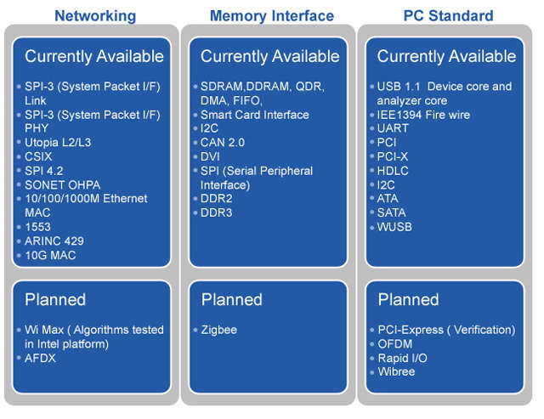
HCL High Tech Segment Focus
Semiconductors: Solution & Framework
Tool side Solutions:
HCL iDA: EDA implementation covering E120,E125,E132,E134
HCL GEM: GEM E30 implementation
HCL SPI: SECSII (E5), SECSI (E4) & HSMS (E37) solution
HCL 300mm: 300mm stack compliant to OS(E39), CMS(E87), PJM(E40), CJM(E94), STS(E90) & EPT(E116)
Factory side Solutions
HCL RAM: RAM E10 implementation
HCL eDiag: diagnostics framework compliant to EEC guideline L0 & L1 capabilities
HCL IFA: Factory side framework compliant to Equipment Engineering Capability guideline
Automated Compliance Test Solutions
SimQualify200: GEM & SECS compliance testing tools
SimQualify300: 300mm standard compliance testing tools
SimQualifyEDA: EDA compliance testing tools
Silicon Solution Accelerator
Notes:
http://www.hcltech.com/semiconductors/solutions-frameworks

Slide 36
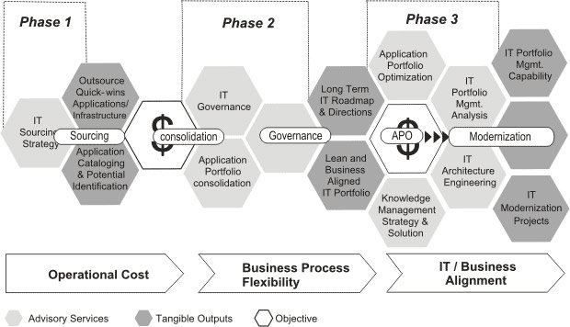
HCL High Tech Segment Focus
Professional Services: Service Portfolio
Business Transformation
HCL consulting practice has evolved into a mature practice with proven capabilities to transform the client’s organization.
HCL clientele includes leading telecom service provider, global banking and financial group, leading education and publishing department of a leading university, leading Asian passenger automotive distributor world’s largest industrial gases company, one of the largest petroleum refining companies in the world to mention a few.
Business transformation services offers to address business issues of the organizations by seamlessly integrating business process across the organization and in defining implementation road map for assured returns.
Technology Transformation Services
HCL's Technology Transformation Services are designed to ensure that IT systems do not become a drag but are optimized and managed so as to transform business functions by being better-aligned to business needs while ensuring operational efficiency.
HCL brings unique strengths to organizations engaged in a significant Business Transformation exercise to create competitive advantage. To such organizations, we offer a clear Transformation roadmap leveraging the Step-IT-Up Methodology as shown in Figure and a mature portfolio of services.

Slide 37
HCL High Tech Segment Focus
Professional Services: Service Portfolio
IT Transformation
Optimize support cost by resource optimization, process optimization, delivery model optimization and tools optimization
Improved delivery effectiveness by establishing end to end SLA’s driven by business requirements and enabled by a structured Service Catalog
Facilitate continuous improvement by establishing a governance model with clear focus on KPI’s and metrics
Independent Verification & Validation
HCL Independent Verification & Validation Service division is a centralized Testing organization that services all verticals and horizontals in the enterprise. It is a one-stop shop for Quality Assurance and Deployment needs of business organizations.
HCL’s IV & VS combines capability in enterprise applications testing along with the rigor of product testing, an area in which HCL has a proven expertise. HCL’s IV&VS practice is facilitated by a large pool of dedicated testing professionals cutting across various domains such as BFSI, Aerospace, MPEG, and Life Sciences with expertise on various tools and technologies.
Enterprise Content Management & Portal
HCL’s Enterprise Content Management (ECM) solutions focus on mapping the Customer Organizations’ business objectives with the content management strategy. This is to ensure the relevance of a long-term perspective for content management and to take our customers up the leadership curve.
With over 16+ years of experience and partnerships with Enterprise Content Management solution providers, the Enterprise Content Management & Portal group at HCL has been at the forefront in delivering Enterprise Content Management (ECM) solutions using cutting edge technologies. On this journey HCL has developed partnerships with all the leading ECM vendors to gain expertise which has no match.
The Enterprise Content Management (ECM) is focused on providing new age e-Business solutions where content drives the business process across the enterprise. Leveraging a strong team of consultants, HCL offers turnkey solutions to Banking, Insurance, Government, Media & Entertainment, Manufacturing, BPO, EPC, Pharmaceutical and other verticals.
Enterprise Architecture & Process Consulting
HCL’s Enterprise Architecture & Process Consulting (EA & PC) group brings valuable experience and knowledge of working with multiple clients across various verticals to align business and IT .

Slide 38
HCL High Tech Segment Focus
Professional Services: Service Portfolio
Middleware & SOA services
HCL can help to design, develop, operate, or optimize business processes; transform business through integration solutions that leverage the power of SOA; or address application and service integration requirements or even a reuse challenge in an operational business process.
HCL services and propositions are backed by proven methodologies, tools and rich partnerships with tool vendors like TIBCO, Software AG, Oracle, SAP & IBM to name a few.
HCL have customers across the globe in multiple industry verticals like Retail & CPG, Hi Tech & Manufacturing, Life Sciences & Healthcare, Media & Entertainment, Transportation, Travel & Logistics, and Banking, Financial Services & Insurance sectors among others.
Their services included SOA services, Service oriented integration services, BPM services, Identity & access management, EDI & B2B services, SOA & BPM consulting.
Data Warehousing & BI
HCL Process Quality Consulting helps in streamlining the IT processes and build capability in meeting business expectations. It has an array of process improvement services for diverse domains & business sizes.
HCL process improvement services span the entire continuum of IT process related improvements ranging from Current State Analysis, Roadmap and Strategy Preparation, Process definitions, implementation support & training to Process assessments. The below diagram provides a snapshot of various process related services provided by the group that can be implemented across the project lifecycle.
Process Design Services:
Process Design Services is a niche offering provided by HCL, where the client’s process are designed to meet the business objectives. HCL Process Quality Consulting can design processes for Development lifecycle/s Maintenance Project Management and IT service management by leveraging Industry best practices, models like CMMI, ITIL, Agile and HCL’s experiences.
HCL Process Quality Consulting has helped a leading global bank to achieve Process standardization across various business units (consisting 400 projects) as per the Bank’s Governance standards by leveraging CMMI & ITIL.
Process Assurance Services:
CL process assurance service enables an organization to strengthen their end-to-end process implementation across the software lifecycle. The main objective of process assurance services are: Standardize process across the Software lifecycle, Common ways of working, Early detection of defects in the software development lifecycle
A top Pharmaceutical company saved 2 million US dollars by adopting COQ based Quality gates and defect prevention.

Slide 39
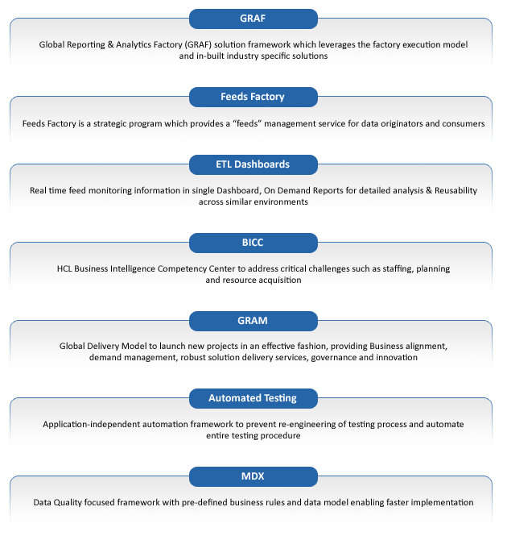
HCL High Tech Segment Focus
Professional Services: Service Portfolio
Data Warehousing & BI

Slide 40
HCL High Tech Segment Focus
Professional Services: Solution & Framework
HCL AEGIS
Features:
AEGIS gives the control of the house to the owner so that the owner is always connected to his house and in control of his house. AEGIS provides:
1. Security and Surveillance
Detection of motion, smoke etc and communicating to the user
Control and configuration of all sensors and security cameras
Video feed from security camera is sent to user when an event trigger occurs
Extending the alert / control interface to a mobile phone
2. Energy Monitoring
Collect energy usage data from energy meter and sends it to the utility
Registering with utility provider and receiving energy floating rates
3. Appliance Control
Controlling various home devices like AC, refrigerator, Heater etc.
Light control (on/off, dimming, presence based control)
remotely control doors and windows
4. Multimedia Control
Seamlessly access of multimedia content from any supported device like Digital Photo frame, PC, TV etc.
Seamless rendering of media data to any device
Accessing TV EPG on the MID/tablet and remote
Benefits of AEGIS:
3 Screen Interface - Web, Mobile, Set Top Box Minimal Setup Configuration
Low cost, Platform Agnostic Solution
Cloud Integration for Secure Remote Access
Standards based Solution (Zigbee/Z Wave)
Media Control through DLNA

Slide 41
HCL High Tech Segment Focus
Professional Services: Solution & Framework
Solar Point Data analysis & inference system
Features:
Web-based system with role-based authentication mechanism.
Location-wise, plant-wise and panel-wise drill down for tracking pre-defined parameters and health of the sub-systems.
Near real-time and accurate performance and health monitoring for given weather conditions.
Root cause analysis.
Emission footprint measurement (carbon credit).
Statistical inference and hypothesis testing.
Statistically assess the impact of assembly line or shift on the end product efficiency.
Warranty agreement violation alerts and warranty renewal alerts.
Scheduler to help demand response.
Monitoring solution for the rooftops - Sell your modules through pay-per-use

Slide 42
HCL High Tech Segment Focus
Servers & Storage
HCL Expertise
Vast experience: HCL offers technology-specific capabilities in solid state drive (SSD), de-duplication, FCoE, FS, SAS/SATA, ISCSI high-performance computing and server virtualization of host side stacks, network entities, and storage devices. The more than 100 SNIA certified professionals in HCL’s Servers and Storage practice focus on providing design, development, and support and maintenance services to the ecosystem.
Deep domain knowledge: Armed with this experience and deep domain knowledge, we have helped customers address both current and future trends in front- and back-office processes.
Industry understanding: HCL have developed heat maps for the CIO that address agility-related demands. They have also helped companies enhance their interactions with partners, gain a 360-degree view of their customers, increase visibility in their supply chains.
A proprietary framework. Through proprietary framework —Managed Application Services (MaSCoT), which manages processes such as quality, governance, transformation, knowledge, test, project, and demand.
Comprehensive IT solutions. For over thirty years, HCL has been providing IT solutions across application managed services, application testing, CRM, aftermarket services, infrastructure management, business process outsourcing, and product life cycle solutions.
Enterprise Application Services. HCL’s acquisition of AXON combined the best of AXON’s strong business consulting and implementation capabilities and HCL’s robust global delivery-based application and infrastructure management capabilities. HCL deliver unique value on an end-to-end basis for SAP, Oracle, and Microsoft customers, ensuring that they receive the optimal business transformation solution at the right price.
Richer mobility experience. HCL’s mobility solutions enable organizations to become highly productive and customer centric by making information available at the right time to the right person .HCL’s Mobility CoE offerings include mobile application development, enterprise mobile offerings, system integration services, and managed services. Key current partnerships include Sybase and RIM. HCL is investing in this space with initiatives such as the Network Solution Lab, a dedicated mobility center in Singapore, and through alliances with several universities.
HCL Offerings
Implementation through leveraging industry best practices with project and change management capabilities
Engineering services across the computing and storage domain; product sustenance services; quality and assurance testing
Micro-verticalization strategy that delivers deeper domain capabilities and thought leadership through our practice team
Dedicated CoEs for “Accelerated Delivery for Solid State Device” and fiber channels provide concept-to-manufacturing services across various product lines
Comprehensive best-in-industry mature framework for Managed Application Services – MASCOT – covering scope management, pricing models, governance, reporting mechanisms, and delivery structures

Slide 43
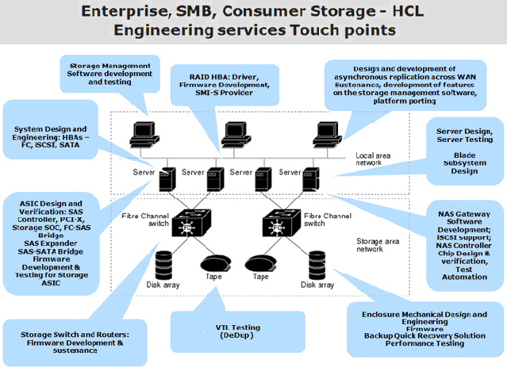
HCL High Tech Segment Focus
Servers & Storage: Services Portfolio
Engineering Services
Notes:
http://www.hcltech.com/servers-and-storage/service-portfolio

Slide 44
HCL High Tech Segment Focus
Servers & Storage: Services Portfolio
Engineering Services
Product conceptualization and design
Prototype and full Product development
Test automation
Major Feature addition
Porting to various OS
Product and EOL sustaining
Product testing
OEM qualification
Customer support
Release management
Product / User documentation
Product Sustenance
Integration and Functional testing
Stress testing
Regression testing
Interoperability testing
Protocol conformance testing
Automation using HCL or 3rd party Test Automation Framework
Development of Test Automation Framework
Product Quality & Assurance testing
Notes:
http://www.hcltech.com/servers-and-storage/service-portfolio

Slide 45
HCL High Tech Segment Focus
Servers & Storage: Services Portfolio
Managed Services
The key value proposition for Managed Services is to deliver 'predictable services at a predictable cost' with continuous improvements and proactive value addition.
The key benefit to customer is that it has to pay less for the same quality of service or gets a higher quality of service for the same price over successive years.
Overview
HCL has a comprehensive best-in-industry mature framework for managed services covering scope management, pricing models, governance & reporting mechanisms and delivery structures. Besides this, MASCOT also supports all processes in Managed Application Services including quality assurance, knowledge management, test management, project management, demand management, governance and transformation.
Framework
Reduce TCO
Achieve predictable cost through application-based pricing for support and RICE/F (Reports, Interfaces, Conversions, Enhancements and Forms) based pricing for application development
Gain access to best of breed tools at a reduced cost
Free up management bandwidth to focus on core business
Enable improvement in processes by leveraging the mature processes (CMMi/ ITIL) of the vendor
Enable creation of Knowledge Management framework
Benefits
Notes:
http://www.hcltech.com/servers-and-storage/solutions-frameworks

Slide 46
HCL High Tech Segment Focus
Servers & Storage: Solution & Framework
FCoE would greatly benefit from having Data Center Ethernet
FCoE enables SAN traffic to be natively transported over Ethernet links, instead of physical FC links
The protocol is being defined by T11 organization INCITS project FC-BB-5
HCL has an FCoE solution accelerator that will enormously benefit Ethernet network OEMs in their FCoE Initiatives
Cost savings of minimum 40% when compared with traditional effort based approach
Faster time to market by squeezing software development timelines by atleast 50%
FCoE
Optimizes time, effort & cost in product testing
Eases test automation process
Dedicated technical support team
User documentation with training
Availability of future enhancements
Test Automation Framework
Development Framework for SMI-S Providers:
SMI-S Provider Development Framework enables vendors to reduce time-to-market of SMI-S compliant products. The framework can be used to develop SMI-S provider for any storage device. Products with SMI-S provider ensure interoperability and simplified management of enterprise SAN environments.
Features:
Support for Instance, Method and Association Providers
Facade Design Pattern
CIMOM Neutral
Potentially can save around 15% provider development effort.
SMI-S Framework
Notes:
http://www.hcltech.com/servers-and-storage/solutions-frameworks

Slide 47
HCL Delivery Centers

Slide 48


HCL Global Delivery Centers
34
Stockholm
Sweden - 1 Center
100
70
Eschborn, Hessen
Germany – 1 Center
's-Gravenhage, Zuid-Holland
Netherland – 1 Center
Tokyo,
Japan – 1 Center
22
Sint-Stevens-Woluwe
Belgium – 1 Center
Blagnac Cedex, France
1 Center
India – 54 Centers
500
Eschborn, Hessen Malaysia – 1 Center
US – 27 Centers
UK - 7 Centers
3,899
Engham – 5
London – 5
Craigavon - 1
New (GDC for BPO)
Philippines – 1 Center
400
400
Brazil – 2 Centers
30
North Sydney, NSW
Australia – 1 Center
Computer Services
Waste Management Services
Software and Programming
Business Services
Retail Technology Support
Financial Services Support
Auckland & Wellington
NewZeland – 2 Centers
Headcounts
Note : No of Headcount was not available for all the countries

Slide 49
HCL Key Offerings in High Tech: SCM, Cloud, PLM

Slide 50
HCL Key Offerings in High Tech:
Service Focus
SAP& CRM-Enterprise Application Management Services | HCL has been providing Enterprise Application Management and Support (AMS) services to customers across the globe for over 15 years. We offer a mature SAP Application Management Service model where across the application lifecycle — right from transition to steady state — we deliver continuous business improvements, by leveraging innovative offerings, tools, methodologies and industry’s most SAP experienced resources.
Supply Chain Analytics Solution | HCL Enterprise Application Services (EAS) provides robust Supply Chain Management solutions with advanced features and benefits helping organizations to generate value and enable their business through a more adaptive supply chain network thus reducing inventory whilst increasing service quality by collaboration, planning, execution and monitoring of activities across the supply chain.
Product Life Cycle Management | HCL helps its customers in creating and delivering innovative products and services which give them a cutting edge over competitors. HCL provides configuration and customization of SAP PLM solution which helps in reducing "Time to Market" and adding value throughout the product development lifecycle
Cloud Services | HCL is a formidable cloud service partner for global organizations with coherent thinking and strategy in place. HCL work with 8 out of Top 10 ISV's in their Cloud Initiatives HCL's approach is centered on building & providing competency based services such as Cloud Assessment, Implementation & Migration to Private, Public and Hybrid Clouds and Cloud Operations services.

Slide 51
Key Offerings in High Tech:
Supply Chain Analytics
Overview
HCL Enterprise Application Services (EAS) provides robust Supply Chain Management solutions with advanced features and benefits helping organizations to generate value and enable their business through a more adaptive supply chain network thus reducing inventory whilst increasing service quality.
For example SCM solution provides functionality for manufacturing where planning and logistics makes business network both agile and seamless. Deployment of SCM provides collaboration, planning, execution and monitoring of activities across the supply chain.
EAS Solution
Advanced Planner & Optimizer
Service Parts Planning
Supply Network Collaboration
Event Management
Forecasting and Replenishment
Transportation Management
Manufacturing Operations and Shop Floor Control
Sales and Operations Planning
Value Addition
Maximize return on assets through optimization of demand and supply
Planning and collaboration with business partners through forecasting, optimizing and scheduling time, materials and resources
Streamlining distribution, transportation and logistics, with real time planning processes
Operational excellence – real time and well informed decision making leading to optimum inventory level

Slide 52
Key Offerings in High Tech:
Customer Relationship Management
Overview
HCL EAS has experience in the design and implementation of integrated CRM solutions across a range of industry sectors, including utilities, CPG, public sector and wholesale distribution - solutions which have allowed their clients to improve call centre efficiency, reduce customer churn, increase their revenue growth, grow their customer base and improve customer satisfaction.
As an organization, HCL has successfully delivered solutions that cover all of the major aspects of CRM at every scale. Their expertise is based on real implementation experience, and our focus on business transformation helps to target the applications in the key areas to make a difference to business outcomes.
Achieving Dramatic Growth by proper strategy, and its implementation to be devised.
Customer Relationship Management (CRM) Transformation For Competitive Advantage by providing innovative solutions to cope with the speed and complexities of everyday business
Public Sector Customer Relationship Management (CRM) adoption of a strategic and structured approach by which public sector organizations can attain high customer satisfaction and operational efficiencies.
Customers can be confident of consistent, high quality services accessed through a channel which suits them
Departments have the information and facilities at their fingertips to support them in managing and resolving customer needs
Global Customer Relationship Management (CRM) Capabilities
Benefits
Notes:
http://www.hcltech.com/enterprise-application-services/supply-chain-management-scm

Slide 53
Key Offerings in High Tech:
Product Lifecycle Management
Overview
HCL combines AGILE development approach with HCL Technologies’ proven Concept to Reality product life-cycle. It is a stage gate process whereby each product or template progress from initial idea and concept through business case, design, build, support and enhancement via approval gates and review boards, with appropriate feedback loops and banking of any ideas which do not progress. AGILE development approach facilitates rapid turn-around of high quality products built in most cases to SAP’s certification standards for qualified solutions.
As product innovation becomes an important differentiator for manufacturers, PLM becomes critical to gain competitive advantage in the market. HCL helps its customers in creating and delivering innovative products and services which give them a cutting edge over competitors. HCL provides configuration and customization of SAP PLM solution which helps in reducing "Time to Market" and adding value throughout the product development lifecycle.
Project Management
New Product Development
Engineering Change Management
CAD Data Management
Product Formulation and specification management
Regulatory Compliance
Product portfolio management
Asset Construction & Maintenance
Quality Management Systems
Product merchandising
Service Areas
More SAP PLM implementations than any other partner
Pre-configured IT Project Portfolio Management solution
Recognized experts at rescuing Failed PLM Projects
Thought leaders on SAP PLM - industry speakers
20+ C-Project and xRPM implementations
SME in technical architecture planning for SAP PLM (cProjects, xRPM, EHS and Recipe Management)
Engaged by SAP to test latest release of PLM
Differentiator
Creating innovative products at a fast pace to drive demand
Optimizing product development processes and systems
Generating Business value - reduced costs, high product quality, productivity and more informed decision making
Supporting key processes in time-to-market management, order management and execution, and enterprise management and support
Significantly reducing time to market and time to volume by integrating supply chain management and procurement closely
Providing support for program management and life-cycle data management processes
Integrating PLM with operational systems, such as computer-aided design, ERP, CRM, SRM, and SCM systems thus giving low cost of ownership
Value Addition

Slide 54
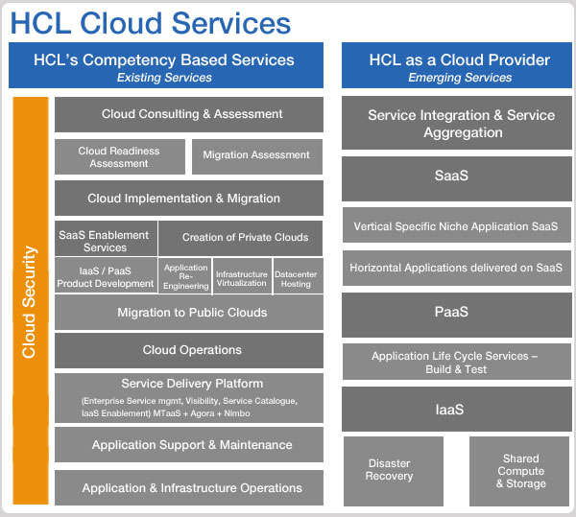
Key Offerings in High Tech:
Cloud Services
Overview
Cloud Computing is of great strategic interest for HCL and strategy is centered on building and delivering competency- and domain-based set of services & delivery models. HCL's cloud services cut across various layers such as Infra as a Service, Platform as a Service and Software as a Service. Their service portfolio are: Cloud consulting & assessment, cloud implementation & migration , cloud management & operations.
Notes:
http://www.hcltech.com/services/cloud-computing/cloud-services-strategy

Slide 55
HCL Hi-Tech Key Differentiator:
R & D AND Innovation

Slide 56
High Tech Differentiators – Focus on R&D
Research &Development and focus on Innovation
Value Portal & Mad Jam: Collaborative Innovation
In 2011, the Value Portal received the Forrester Groundswell Award in the Management: Innovation System category for its phenomenal success and popularity. It is created to funnel the innovation energy of 90,000 employees, especially those at the grassroots level to collaborate, innovate and lead the implementation of their ideas to deliver value to the customers.
While the objective of MAD JAM was to applaud the efforts of the finest innovators at HCL, what was actually being celebrated was a path breaking shift – from leaders driving ideas, to employees giving and then leading great ideas.
Wikiportal & Arkmedes
Wikiportal allowed access to structured and non-structured data through the support of social and collaborative features such as tagging, wikis, blogs, discussion forums, expertise locations, social networks, and more. As a result, Sales productivity has increased due to streamlining day-to-day business operations; over 80% of our sales force is able to respond to customer queries faster and there is a 35% reduction in cycle time through collaboration while responding to RFPs.
Arkmedes created a hot bed of collaboration and innovation within the organization. Not only that, these communities of passion had indirectly created a robust, self-sustaining knowledge management portal that was driven by the very people who contributed to it on a daily basis
MEME: Workplace Collaboration & Communication
300 + project specific work groups on MEME have helped in creating business ideas with benefits of over USD 25 million+.
MEME users leveraged this platform extremely well by creating a direct interface with various enabling functions like Human Resources (HR), IT Help Desk and Other Service Desks. Rather than going the traditional way, employees directly sought answers to their queries in a virtual fashion.
MEME is also being leveraged by various enabling function to conduct different surveys in most the transparent manner.
2013 R&D Supplier Ranking by Zinnov
HCL is placed at Expansive-Established quadrant in R&D practice, innovation, scale & others parameter as per Zinnov Global Service Provider Rating.
HCL is at the LEADERSHIP zone in R&D practice, innovation in Computer peripheral & storage devices as per Zinnov Global Service Provider Rating.
HCL is at the LEADERSHIP zone in R&D practice, innovation in Consumer electronics as per Zinnov Global Service Provider Rating.
HCL is at the LEADERSHIP zone in R&D practice, innovation in Enterprise software as per Zinnov Global Service Provider Rating.
HCL is at the LEADERSHIP zone in R&D practice, innovation in Consumer software as per Zinnov Global Service Provider Rating.
HCL is at the LEADERSHIP zone in R&D practice, innovation in Semiconductor as per Zinnov Global Service Provider Rating.
Notes:
http://www.hcltech.com/i-have-an-idea/innovation-at-hcl

Slide 57
HCL Key Alliances

Slide 58




Strategic Partners
HCL Technologies Strategic Partners
 | The Enterprise Application Services (EAS) division of HCL Technologies extended its overall partnership with SAP by signing a new global managed mobility agreement. HCL will now be permitted to resell, implement and host industry-leading SAP® solutions, including the SAP Mobile Platform, the SAP Afaria® mobile device management solution, and the extensive portfolio of SAP mobile apps. Signed a global partnership agreement with SAP to offer a mobility-related offering called ‘Managed Mobility.’ Its scope includes Road Mapping, Mobile Application Development, Mobile Application Management, Mobile Application Testing and Mobility Outsourcing. The agreement benefits HCL by enabling them to resell and host SAP Mobility Platform (Sybase Unwire Platform, Afaria and Syclo) licenses.
 | HCL Tech has developed ‘FinEdge Wealth’, a wealth management solution on MS Dynamics CRM. The FinEdge Wealth CRM solution will enable wealth management companies to track and manage customer interactions and adapt programs to changing customer market segments.
 | HCL launched two mobile based analytics solutions -‘HCL PREDICT’ and ‘HCL CONNECT’ on the Salesforce.com platform
 | The objective was to collaborate with innovative IT organizations such as Cisco and create a solution that enables the target Industries to achieve greater flexibility, multi-channel delivery, improved customer experience and delivers those through flexible business models.

Slide 59





Strategic Partners
HCL Technologies Strategic Partners
 | HCL Technologies is a Certified Member of the Xilinx Alliance Program and has demonstrated qualified expertise on the latest Xilinx devices and implementation techniques on Xilinx programmable platforms.
 | HCL is partner for Informatica for APAC, US & Canada. HCL and informatica are focusing on providing Data Integration Solutions to different verticals including Financial services, Insurance, Healthcare, Life sciences, Telecommunications etc.
 | HCL & BMC software share a strategic alliance wherein HCL is BMC's Global Outsourcer, SI Partner & Global Managed Service Provider Partner. This partnership allows HCL to focus upon all the major BMC disciplines of Business Service Management such as Service Resource Planning, Service Automation, Service Support, Service Assurance & Atrium Core, and has a dedicated technology team known as 'Center of Excellence' which proactively develop/deploy these solutions.
 | The HCL/EMC Alliance program has enabled HCL to partner with EMC to cut costs and/or improve client operations through refresh, content management, consolidation, upgrade, virtualization (VMWare) and security (RSA) programs. HCL is a Gold Tier Partner and a part of the Velocity Global Alliances Program - a ‘best in class’ Alliance Partner program. HCL delivers full lifecycle EMC based Documentum Content Management Solutions including Package Implementation, Customization, Support Upgrade/Migration, Reengineering .
 | HCL and CA have established a strategic relationship to meet the Enterprise IT Management needs of customers. The partnership is focused on solutions around CA's ‘Govern’, ‘Secure’ and ‘Manage’ products across distributed and mainframe environments. The HCL-CA partnership combines CA's leadership in platform technologies and HCL's business transformation services to deliver efficiency and cost advantage for customers.

Slide 60




Strategic Partners
HCL Technologies Strategic Partners
 | HCL and SAP together focus on proving business solutions to customers in areas including Consulting services, Systems integration services and Support for evaluation, implementation and continuous improvement. HCL is also a Value Added Re-seller in India and additionally collaborates with various Industry Business Units (IBUs) of SAP to bring Intellectual Property to the IBUs through a focused strategy of solutions.
 | HCL has a 6+ year relationship with Oracle Corporation and is their Worldwide Platinum Partner. Besides this, they have partnerships with Oracle to resell their application and technology products in various parts of the Globe.
 | As a TIBCO Alliance Partner HCL has built a dedicated Center of Excellence featuring 550+ TIBCO Consultants experienced with Service Oriented Architecture, Enterprise Message Service, Complex Event Processing, Business Process Management, Application Integration, Adapters, Portal Builder and Portal Packs and B2B.
 | HCL, as a Global Systems Integrator for HP, is able to offer a comprehensive suite of solutions to Customer by utilizing HP hardware and software platforms. As a Global Alliance partner HCL offers a comprehensive suite of Infrastructure and Enterprise Transformational Services that effectively utilize HP’s extensive portfolio of products .
 | HCL leverages a broad range of IBM products to build world class, flexible and industry leading infrastructure and business intelligence solutions. HCL delivers full lifecycle IBM based FileNet Content Management Solutions including Package Implementation, Customization, Support Upgrade/Migration, Reengineering .
 | Under the partnership, HCL will transfer its commercial lending software product (Finance Center) business, including customer contracts and other associated assets and liabilities for consideration of $45 million while supporting Linedata with offshore product development and professional services. HCL had derived revenue of $30 million during FY 12 from Capital Stream.

Slide 61





Strategic Partners
HCL Technologies Strategic Partners
 | HCL AXON launched a joint enterprise mobility solution on its HCL Citizen Connect™ platform, developed as a part of HCL's global strategic alliance with Radio IP Software. The rationale was to offer mobility solution offerings, coupled with GTM strategy, to the customers of HCL and Radio IP Software. Further, the offerings could also be used to attract prospective clients in the Public Service Markets globally.
 | INFONOVA and HCL-BPO Services announced a joint go-to-market with Infonova’s BSS 6, a transformation model to put state-of-the-art Business Support Systems into efficient operation. HCL claimed that clients will experience a dramatic improvement to all their operating metrics and faster outcomes by employing this solution.
 | HCL and Consumers Energy will collaborate on a new “Glocal” Center of Excellence (GCoE) called the Michigan Technology Development Center (MTDC). The Center will be located at the Commonwealth Commerce Center in downtown Jackson, Michigan.
 | HCL’s existing relationship with JDA extending HCL’s offerings in professional services for industries such as retail, manufacturing, CPG and life sciences for the Americas and the Europe.
 | HCL Tech partnered with Siemens PLM Software to accelerate new product development and reduce time to market. The partnership aims to accelerate client adoption of PLM software and services, thereby enhancing product development and enabling reduced time-to-market for manufacturing companies in India.

Slide 62











Strategic Partners
HCL Technologies Strategic Partners

Slide 63
HCL Hi-Tech: Analyst Benchmarking

Slide 64
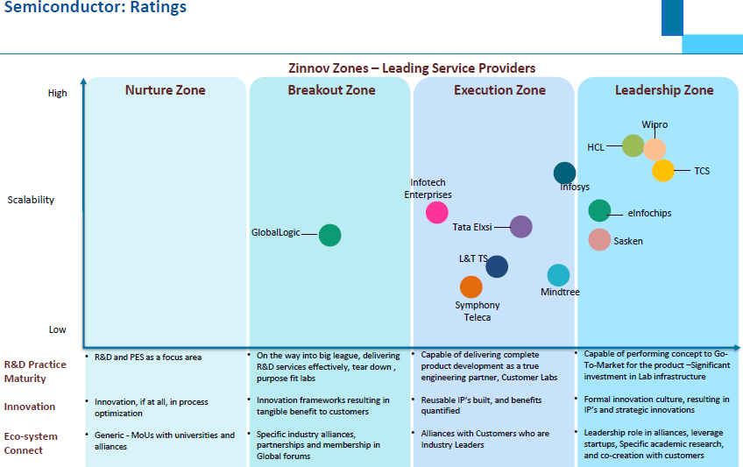
Analyst Benchmarking – 2013 Zinnov R&D

Slide 65
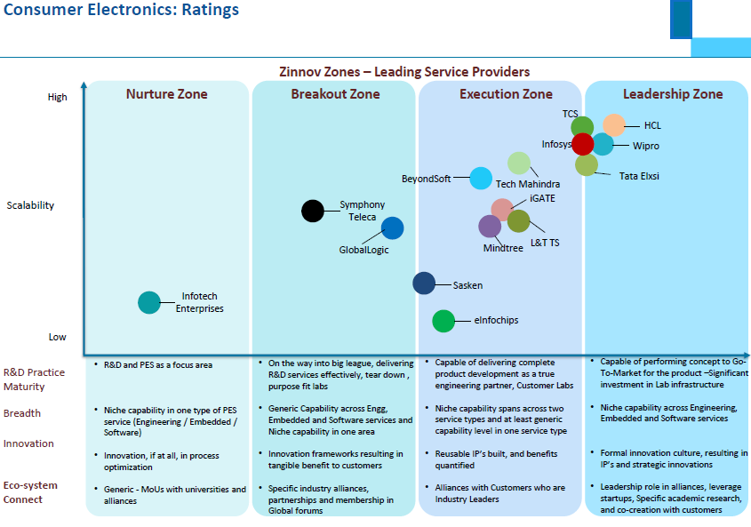
Analyst Benchmarking – 2013 Zinnov R&D

Slide 66
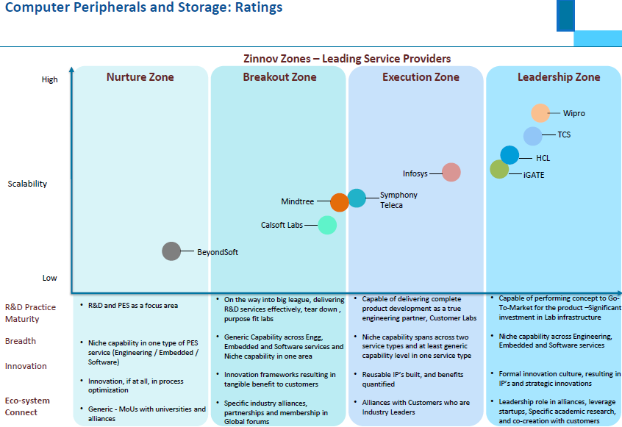
Analyst Benchmarking – 2013 Zinnov R&D

Slide 67
Analyst Benchmarking - HCL Vs TCS
Technology
HCL
TCS
Challenger in the Gartner’s Magic quadrant for SAP application implementation.
HCL which acquired the U.K.-based SAP specialist, Axon, in 2008
HCL derived SAP implementation revenue from 13 of the 22 industries defined in this Magic Quadrant, the key ones being aerospace and defense, oil and gas, utilities and energy, transportation, consumer goods, manufacturing, and life sciences
Challenger in the Gartner’s Magic quadrant for SAP application outsourcing.
First Indian provider to become a global SAP services partner
Leading offshore firm in the SAP services market
SAP
(Implementation)
Finance & Accounting BPO
Visionaries in the Gartner’s Magic quadrant for finance & accounting BPO.
HCL wants to pursue more strategic
partnership types of F&A BPO, and it has successfully achieved these partnerships with two major banks and a global custodian for F&A BPO services
Leader in the Gartner’s Magic quadrant for finance & accounting BPO.
. TCS is adaptable to making modifications with a strong process delivery
and transition methodology. This strength is shown through an ability to deliver operational improvement.

Slide 68



Analyst Benchmarking
Parameter | Position
HCL is a highly experienced datacenter outsourcer in Europe and has over the past few years built credibility in transformation, which gives it the brand permission to undertake large transformational tasks, says IDC in a report titled "IT Service Providers' Cloud Strategies in Europe 2013, June 2013” | NA
Parameter | Position
HCL Technologies has been ranked as a market leader for Enterprise Mobility and Cloud Services | Leader
Parameter | Position
HCL has been positioned as a leader in the Forrester Wave: Enterprise Mobility Services, Q1 2013, (Forrester Research, Inc., March 25, 2013 by William Martorelli and Wolfgang Benkel, Forrester Research Inc., February 15, 2013 by Liz Herbert ) | Leader
Parameter | Position
HCL has been profiled in the list of Top Five Service Providers with Robust SCM BPO Capabilities in Everest Group report “Supply Chain Management BPO Beyond Procurement Outsourcing” published by Saurabh Gupta – Vice President, Abhishek Menon – Practice Director, Vishnu Khandelwal – Senior Analyst, Everest Group.

Slide 69

Analyst Benchmarking
Parameter | Position
Gartner Magic Quadrant for SAP Implementation Service Providers, North America | Leader
Magic Quadrant for Data Center Outsourcing and Infrastructure Utility Services, North America. In this report Gartner examines the abilities of 20 service providers' to deliver Datacenter Outsourcing and infrastructure utility services in North America, and their vision for the future of these services. | Leader
Gartner Magic Quadrant for Desktop outsourcing Services, North America | Leader
Gartner Magic Quadrant for Helpdesk outsourcing , North America | Leader

Slide 70
HCL Hi-Tech: Key Investments

Slide 71
Key Investments and focus of Future investment
February
HCL announces Strategic Partnership with software provider nMetric.
HCL AXON And NextLabs forge strategic Go-to-market partnership agreement to enhance Customer Data Security
Electrolux Signs 5 Year IT Infrastructure Management Engagement for Asia/Pacific with HCL Technologies Limited
April
Melbourne IT Grants business systems transformation project to HCL Technologies Limited
May
HCL Technologies Limited signs Five-Year, strategic engagement agreement with MSD
HCL Technologies Limited and Stellar Asia Pacific form strategic partnership to further expand business In Australia and APAC
June
HCL Technologies Limited forms strategic partnership with Callatay & W outers (C&W)
SGX signs IT infrastructure agreement with HCL Technologies Limited
August
HCL announces partnership with Texas Instruments
October
HCL and Odessa sign strategic partnership deal
November
HCL Signs Deal with Novotech to implement Oracle's Siebel Clinical Trial Management System
HCL enters into multi year end-to-end IT Infrastructure management engagement with Purdue Pharma L.P
2010

Slide 72
Key Investments and focus of Future investment
February
HCL announces strategic partnership with Tangoe Inc
April
HCL in pact with JDA Software for Supply Chain Software Services.
June
HCL and Epicor Software Corporation sign long term strategic partnership
HCL signs five year Engineering Services pact with Xerox.
October
Cast SA announces strategic partnership with HCL
2011
February
HCL enters into strategic relationship with State Street to provide BPO services.
HCL enters into strategic partnership with Linedata
March
Linedata Services SA finalizes acquisition of CapitalStream Credit & Risk Management Solution; launches strategic partnership with HCL Technologies
2012
September
Gtech SpA's subsidiary signs agreement with HCL to receive technical operations services in Sweden
2013
Focus of Future
Focus on disruptive new propositions like EFaaSTM, ALT ASM, Enterprise of Future and Innovation Monetization to continue to drive its differentiation in the transformational renewal market.
America and Europe together contributed almost 85% of the revenue, whereas, ROW contributed the rest.

Slide 73
HCL Hi-Tech: SWOT

Slide 74
SWOT Analysis
Strength
Opportunities
In financial year 2012-13, HCL Tech has registered more than 50% of growth in profit, Manufacturing vertical where High Tech has been reported has shown a good growth & large revenue portion.
HCL has strong competency in all sub segments of High Tech like ISV, consumer electronics,professional services. The solutions offered in different sector reflect that.
HCL is placed at the leadership zone in research & development as per zinnov latest research for all High Tech sub segments.
HCL has been focusing on technology led business process transformation.
Axon acquisition considered a silver bullet which make HCL’s SAP service stronger than earlier.
HCL Has been focusing on technology led business process transformation'
Positive outlook for IT services as outsourcing industry is expected to reach $175 bn by 2020 (NASSCOM)
Growing SaaS market & Emergence of Cloud computing has opened lots of opportunity to HCL to aim.
Improving scenario in Hi-Tech industry can be a big opportunity for HCL to grab & move up the ladder.
Weakness
Threats
The attrition rate for IT services in the fourth quarter of 2013 has been reported as 14.9%, which was around 14.2% in the fourth quarter.
Overly aggressive acquisition brings risks of additional staff in high-cost geographies.
Financial slowdown has impacted the High Tech overall growth.
Almost 86% of HCL’s business comes from Americas and Europe. Any negative change in these markets could impact HCL’s business severely.
Rising wage inflation in India leading to margin pressure
Hi Tech industry is characterized by cyclic demand and shorter life cycle
Intense competition in Hi Tech segment from low cost service providers such as TCS, Wipro.

Slide 75
HCL Hi-Tech: Key Executives & Profiles

Slide 76
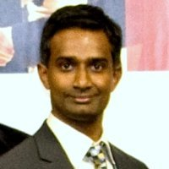

Key Executives and Profiles
Karthik Narain–Vice president & Vertical Head Hi-Tech
Career Path:
Responsibility for managing the High Tech business for HCL.
Heading a P&L of $150M in delivering IT services.
Responsible for creation of business plan, sales and marketing strategy for High Tech business in North America.
Earlier he was associated with Infosys & TCS.
Education:
Bharathidasan University
Masters, Information Systems and Management
1997 – 1998
Institute of Cost and Works Accountants of India - ICWAI
Intermediate, Cost and Management Accounting
1993 – 1996
University of Madras
Bachelors, Commerce and Management
LinkedIn profile:
http://www.linkedin.com/pub/karthik-narain/4/949/6b4
Rajan Bedi-Presales Head for Hi-tech and Manufacturing Engineering Services
He earlier has worked with HCL-Axon & ITC Infotech.
Rajan holds MBA from IMT, Ghaziabad.
LinkedIn profile:
http://www.linkedin.com/pub/rajan-bedi/1/622/422

Slide 77

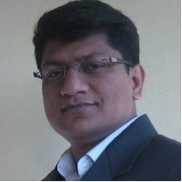
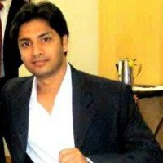

Key Executives and Profiles
Arun Pai- Senior Vice President - Global Hi-tech & Manufacturing
Currently heading the Global Hi-tech and Manufacturing vertical with complete P & L responsibility and overseeing the Sales, Pre-Sales, Solutions and Bid teams.
Earlier, he worked with Patni Computer System, Philips.
He did his engineering from IIT Kharagpur.
LinkedIn profile:
http://www.linkedin.com/profile/view?id=2001008&authType=NAME_SEARCH&authToken=91p8&locale=en_US&srchid=2812411291382018283340&srchindex=1&srchtotal=58&trk=vsrp_people_res_name&trkInfo=VSRPsearchId%3A2812411291382018283340%2CVSRPtargetId%3A2001008%2CVSRPcmpt%3Aprimary
Prakash Ijral- Delivery Unit Head | Enterprise Transformation Services (IV&VS) | Hi-Tech, Manufacturing and TTL verticals
Earlier Prakash was in Symphony Services, Aldata Solution.
He did his MBA from IIM Bangalore.
LinkedIn profile:
http://www.linkedin.com/in/prakashijral
Abhishek Upadhyaya-Deputy Manager (Hi-tech and Manufacturing Engineering Services)
Earlier Abhishek was in Photon Infotech, Adlabs Films Limited.
He did his MBA from IIM Calcutta.
LinkedIn profile:
http://www.linkedin.com/in/abhishek4455
Sanjay Kabra- Hi-tech, Vertical Delivery Head
He did his education from Vani Bharati.
LinkedIn profile:
http://www.linkedin.com/pub/sanjay-kabra/11/701/732

Slide 78

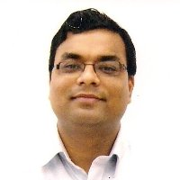

Key Executives and Profiles
Sukamal Banerjee - Head Engineering Services, Hi-Tech & Manufacturing
He leads HCL’s business in North America and Europe for Hi-Tech and Manufacturing market segments. In his career at HCL he has carried several progressive responsibilities and has been instrumental in creating some of HCL’s Top 5 accounts and large scale partnership agreements with customers.
He also was responsible for many of the first of its kind relationships with customers covering unique business models, entry into new geographic markets, entry into new vertical market segments and also pioneering wins of new service lines in the North American market. Currently his global team manages a fast growing $ 400 M business.
Before HCL, he worked as a Software Engineer developing algorithms and software products across several aspects of object modeling and manufacturing outcome optimizations.
Sukamal has a B.S. in Mechanical Engineer from V.J.T.I, Mumbai and did his MBA from Jamnalal Bajaj Institute, Mumbai.
Ratan K- Sr. Manager - Hi-Tech & Manufacturing
Earlier Ratan was Infinite Computer Solutions, Velankani, Lucent Technology.
He did his MBA from IIM Calcutta.
LinkedIn profile:
http://www.linkedin.com/profile/view?id=17358292&authType=OUT_OF_NETWORK&authToken=gUo2&locale=en_US&srchid=2812411291382019508625&srchindex=2&srchtotal=56&trk=vsrp_people_res_name&trkInfo=VSRPsearchId%3A2812411291382019508625%2CVSRPtargetId%3A17358292%2CVSRPcmpt%3Aprimary
Shankar Narayan- Sr. Manager - Regional Director, Hi-Tech Sales
Earlier Shankar was in TCS, Energy Systems, KPIT Cumins, Hassia Reterdation.
He did his engineering from IIT Bombay.
LinkedIn profile:
http://www.linkedin.com/profile/view?id=1250219&authType=OPENLINK&authToken=Vc6Z&locale=en_US&srchid=2812411291382019508625&srchindex=4&srchtotal=56&trk=vsrp_people_res_name&trkInfo=VSRPsearchId%3A2812411291382019508625%2CVSRPtargetId%3A1250219%2CVSRPcmpt%3Aprimary

Slide 79
Send your feedback / suggestions to the analyst team:
Aditi.Royghatak@tcs.com
D.Basak@tcs.com
Sonnet.Das@tcs.com
Aniket.Agao@tcs.com

